Slide 1
Project Management & CT050-3-3-PRMGT
Topic 03: Initiating Projects

Slide 2
TOPIC LEARNING OUTCOME
At the end of this topic, you should be able to:
1. Describe the five project management process groups, define a project life cycle, map the process groups to knowledge areas, discuss other project management methodologies, explain the concept of agile project management, and understand the importance of top management commitment and organizational standards
2. Discuss the initiating process, including pre-initiating activities
3. Prepare a business case to justify the need for a project
4. Identify project stakeholders and perform a stakeholder analysis
5. Create a project charter and assumption log
6. Describe the importance of holding a good project kick-off
meeting

Slide 3
Contents & Structure
Knowledge area | Initiating process | Outputs
Project integration management | Develop project charter | Project charter Assumption log
Project stakeholder management | Identify stakeholders | Stakeholder register Change requests Project management plan updates Project documents updates

Slide 4
Recap From Last Lesson
An organization’s overall business strategy should guide the project selection process and management of those projects
Many organizations follow a traditional approach, often completed in four stages. To make more timely decisions, they can also use an agile approach.
Several methods are available for selecting projects, including financial methods (net present value, return on investment, and payback); weighted scoring models; balanced scorecards; addressing problems, opportunities, and directives; project time frame; and project priority
The main criteria for program selection are the coordination and benefits available by grouping projects
The goal of project portfolio management is to help maximize business value to ensure enterprise success

Slide 5
Project Management Process Groups
Project management process groups progress from initiating activities to planning activities, executing activities, monitoring and controlling activities, and closing activities
A process is a series of actions directed toward a particular result

Slide 6
Description of Process Groups
Initiating processes include actions to begin projects and project phases
Planning processes include devising and maintaining a workable scheme to ensure that the project meets its scope, time, and cost goals as well as organizational needs
Executing processes include coordinating people and other resources to carry out the project plans and produce the deliverables of the project or phase.
A deliverable is a product or service produced or provided as part of a project
Monitoring and controlling processes measure progress toward achieving project goals, monitor deviation from plans, and take corrective action to match progress with plans and customer expectations
Closing processes include formalizing acceptance of the project or phase and bringing it to an orderly end

Slide 7
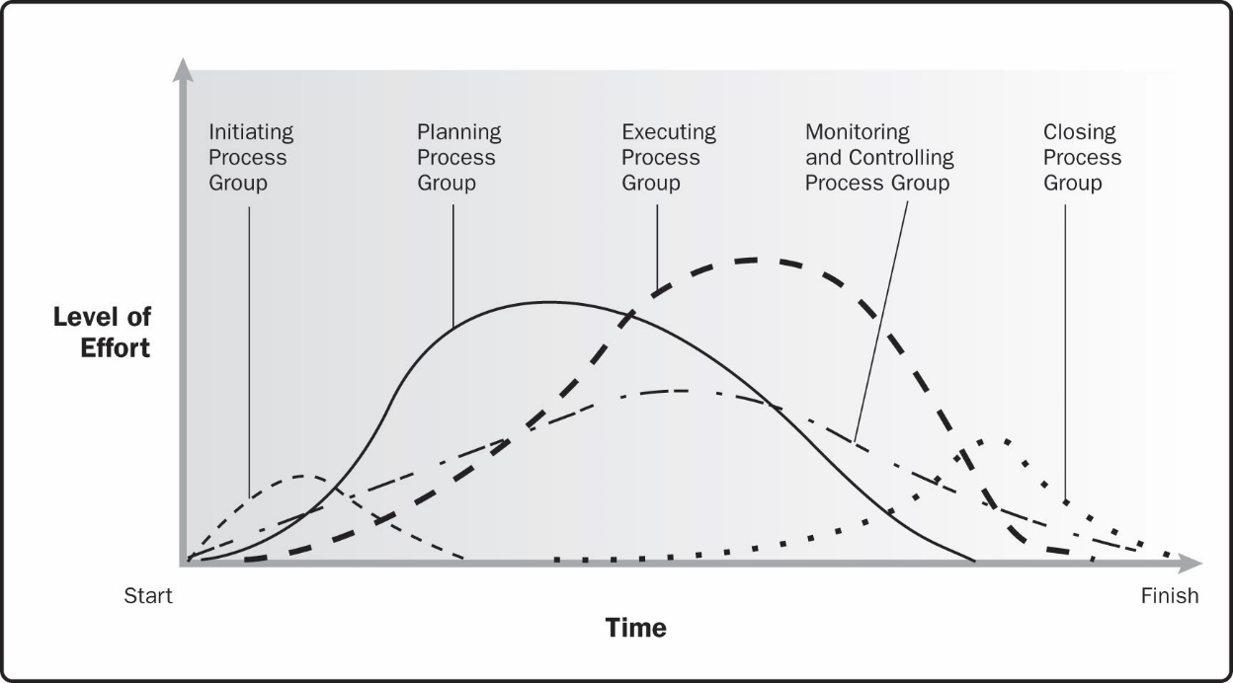
Figure 3-1. Example of process group interactions within a project or phase
Source: Project Management Institute, Inc., A Guide to the Project Management Body of Knowledge (PMBOK® Guide)– Sixth Edition (2017).

Slide 8
Figure 3-2. Time Spent on Each Project Management Process Group
Process Group | Alpha PM |  | Average PM | Alpha Difference (%)
Initiating | 2% | 1% |  | 100% more
Planning | 21% | 11% |  | 91% more
Executing | 69% | 82% |  | 16% less
Monitoring & Controlling | 5% | 4% |  | 25% more
Closing | 3% | 2% |  | 50% more
Total | 100% | 100%

Slide 9
Characteristics of the Process Groups
The level of activity and length of each process group varies for every project
Normally, executing tasks require the most resources and time, followed by planning tasks
Monitoring and controlling processes are done throughout the project’s life span
Initiating and closing tasks are usually the shortest (at the beginning and end of a project or phase, respectively), and they require the least amount of resources and time
However, every project is unique, so there can be exceptions
Note that process groups apply to entire projects as well as to project phases
A phase is a distinct stage in project development, and most projects have distinct phases

Slide 10
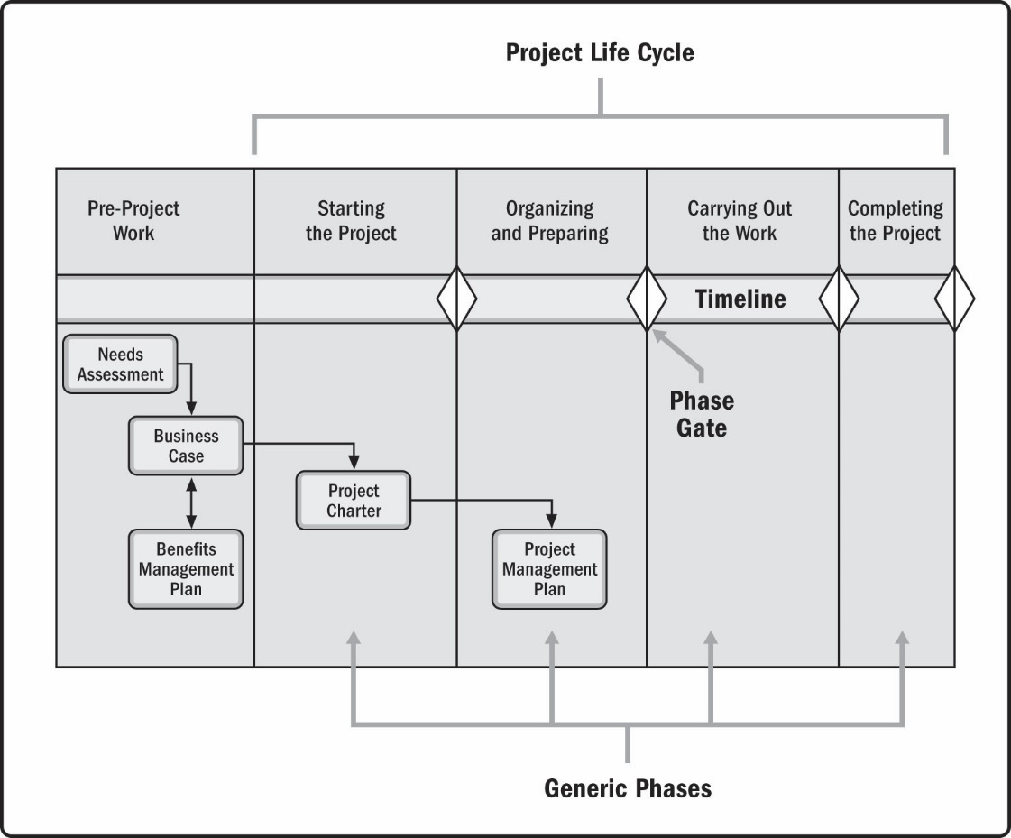
Figure 3-3. Project life cycle and phase gates
Source: Project Management Institute, Inc., A Guide to the Project Management Body of Knowledge (PMBOK® Guide)– Sixth Edition (2017).

Slide 11
Predictive, Adaptive, and Hybrid Life Cycles
A predictive life cycle, also called plan-driven, is used when the requirements can be well defined at the beginning of a project.
An adaptive life cycle is used when requirements are not well defined up front. Adaptive approaches can be iterative, incremental, or agile.
A hybrid or combination of approaches can be used when the nature of different deliverables calls for different approaches.

Slide 12
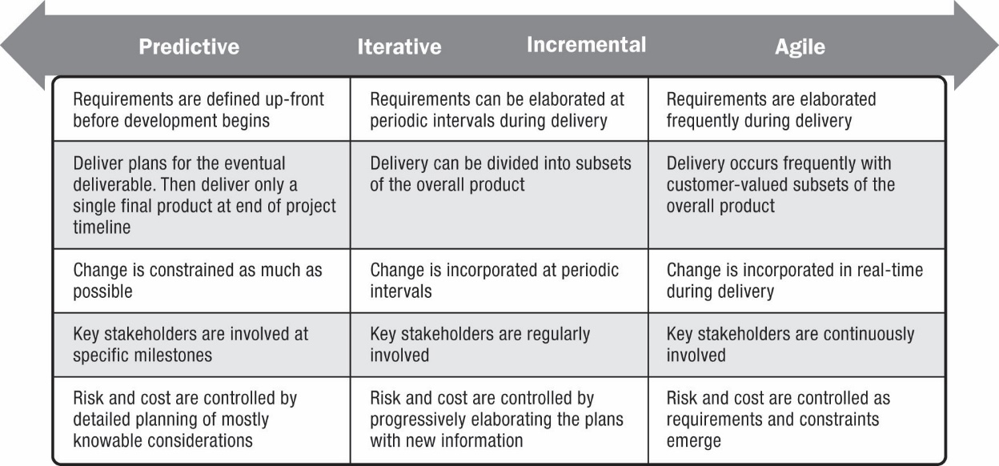
Figure 3-4. The continuum of project life cycles
Source: Project Management Institute, Inc., A Guide to the Project Management Body of Knowledge (PMBOK® Guide)– Sixth Edition (2017).

Slide 13
Mapping the Process Groups to the Knowledge Areas
You can map the five process group into the ten project management knowledge areas
Based on the PMBOK® Guide – Sixth Edition (2017), there are 49 total processes in project management
Figure 3-5 provides a big-picture view of the process groups and knowledge areas

Slide 14
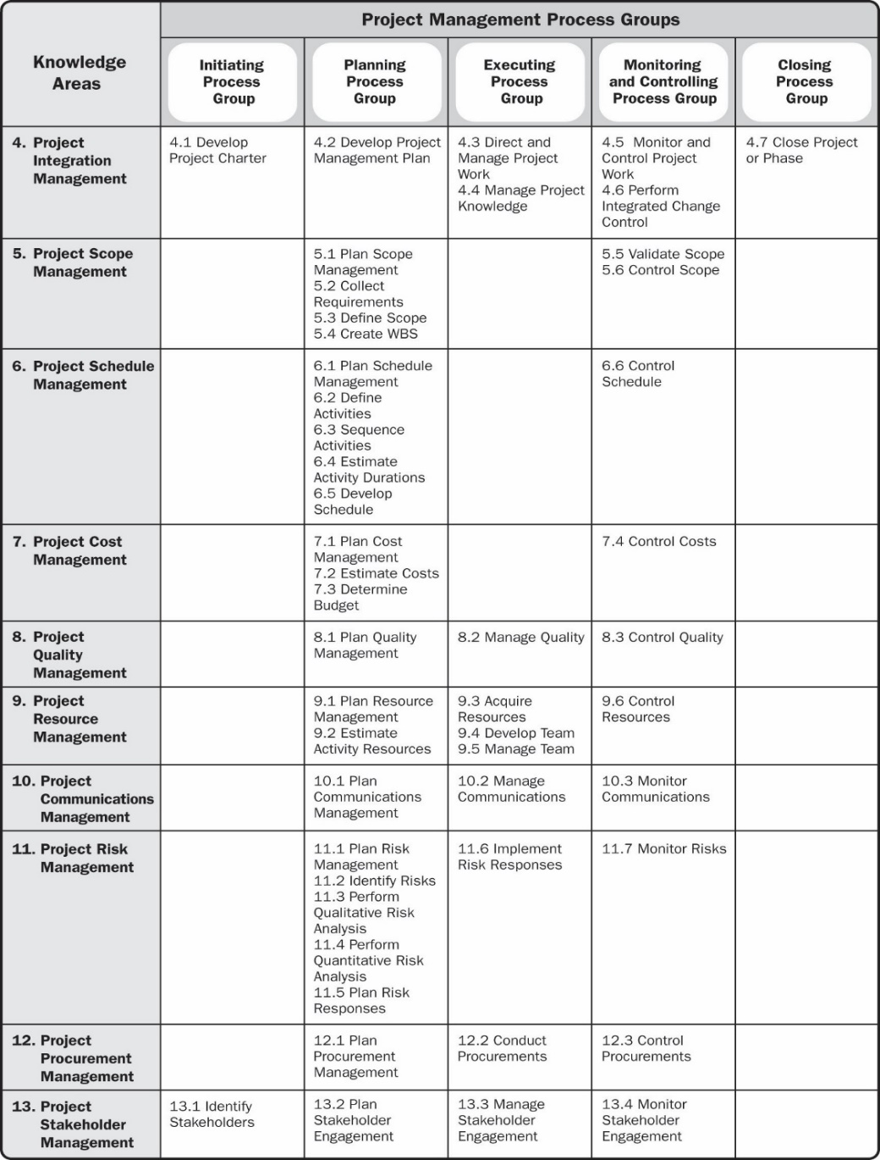
Figure 3-5. Project management process group and knowledge area mapping
Source: Project Management Institute, Inc., A Guide to the Project Management Body of Knowledge (PMBOK® Guide) – Sixth Edition (2017).

Slide 15
Developing a Project Management Methodology
The PMBOK® Guide is a standard that describes best practices for what should be done to manage a project
A methodology describes how things should be done, and different organizations often have different ways of doing things
Successful organizations develop and follow a customized, formal project management process

Slide 16
Other Methodologies
PRojects IN Controlled Environments (PRINCE2): Originally developed for IT projects, PRINCE2 was released in 1996 by the U.K. Office of Government Commerce – now used in over 50 countries
Rational Unified Process (RUP) framework: iterative software development process that focuses on team productivity and delivers software best practices to all team members
Six Sigma: Used to improve quality and processes. Six Sigma’s target for perfection is the achievement of no more than 3.4 defects, errors, or mistakes per million opportunities
Agile: See following slides

Slide 17
Agile
Many software development projects use agile methods, meaning they use an iterative workflow and incremental delivery of software in short iterations
Popular agile approaches include Scrum, extreme programming, feature driven development, and lean software development.
In 2011, PMI introduced a new certification called Agile Certified Practitioner (ACP) to address the growing interest in agile project management.
Note that agile can also be applied to project planning, as described in Chapter 2, as well as many other areas, including manufacturing and even education.

Slide 18
Manifesto for Agile Software Development (www.agilemanifesto.org)
We are uncovering better ways of developing software by doing it and helping others do it. Through this work we have come to value:
Individuals and interactions over processes and tools Working software over comprehensive documentation Customer collaboration over contract negotiation Responding to change over following a plan
That is, while there is value in the items on the right, we value the items on the left more

Slide 19
Scrum
Scrum is the leading agile development method for completing projects with a complex, innovative scope of work
The term was coined in 1986 in a Harvard Business Review study that compared high-performing, cross-functional teams to the scrum formation used by rugby teams

Slide 20
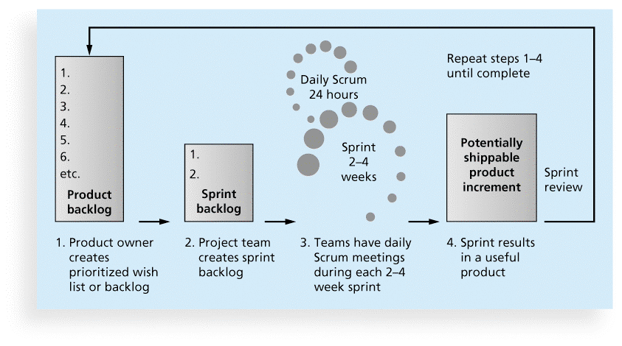
Figure 3-6. Scrum Framework
Schwalbe Information Technology Project Management, Revised Seventh Edition, 2014

Slide 21
Project Management Office (PMO)
A project management office (PMO) is an organizational entity created to assist project managers in achieving project goals
A PMO can help development standards and methodologies, provide career paths for project managers, and assist project managers with training and certification

Slide 22
Possible Goals of a PMO
Collect, organize, and integrate project data for the entire organization
Research, develop, and share best practices in project management
Develop and maintain templates, tools, standards, and methodologies
Develop or coordinate training in various project management topics
Develop and provide a formal career path for project managers
Provide project management consulting services
Provide a structure to house project managers while they are acting in those roles or are between projects

Slide 23
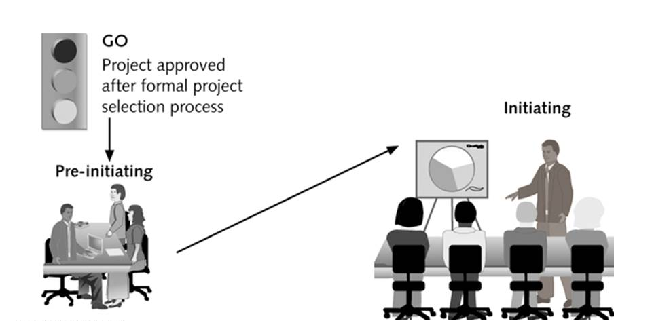
Figure 3-8. Initiating Process Summary
Senior management work together to: Determine scope, time, and cost constraints Identify the project sponsor Select the project manager Develop a business case for the project Review processes/expectations Determine if the project should be divided into two or more smaller projects | Project managers lead efforts to: Identify and understand project stakeholders Create the project charter and assumption log Hold a kick-off meeting

Slide 24
Pre-initiating Processes
It is good practice to lay the groundwork for a project before it officially starts
After a project is approved, senior managers should meet to accomplish the following tasks:
Determine the scope, time, and cost constraints for the project
Identify the project sponsor
Select the project manager
Meet with the project manager to review the process and expectations for managing the project
Determine if the project should be divided into two or more smaller projects because it is easier to manage smaller projects than larger ones

Slide 25
Business Case for a Project
A business case is a document that provides financial justification for investing in a project
Typical contents:
Introduction/Background
Business Objective
Current Situation and Problem/Opportunity Statement
Critical Assumptions and Constraints
Analysis of Options and Recommendations
Preliminary Project Requirements
Budget Estimate and Financial Analysis
Schedule Estimate
Potential Risks
Exhibits
See Figure 3-10 in the text for a sample (pp. 992-94)

Slide 26
Initiating Processes
Identifying project stakeholders
Creating the project charter
Creating the assumption log
Holding a kick-off meeting

Slide 27
Figure 3-11. Initiating Processes and Outputs (PMBOK® Guide – Sixth Edition)
Knowledge area | Initiating process | Outputs
Project integration management | Develop project charter | Project charter Assumption log
Project stakeholder management | Identify stakeholders | Stakeholder register Change requests Project management plan updates Project documents updates

Slide 28
Identifying Stakeholders
Project stakeholders are the people involved in or affected by project activities
Internal project stakeholders generally include the project sponsor, project team, support staff, and internal customers for the project. Other internal stakeholders include top management, other functional managers, and other project managers
External project stakeholders include the project’s customers (if they are external to the organization), competitors, suppliers, and other external groups that are potentially involved in or affected by the project, such as government officials and concerned citizens

Slide 29
Stakeholder Register and Stakeholder Analysis
A stakeholder register is a document that includes details related to the identified project stakeholders -usually available to many people, so it should not include sensitive information
A stakeholder analysis is a technique for analyzing information to determine which stakeholders’ interests to focus on and how to increase stakeholder support throughout the project

Slide 30
Figure 3-12. Sample Stakeholder Register
Name | Position | Internal/ External | Project Role | Contact Information
Mike Sundby | VP of HR | Internal | Project champion | msundy@globalconstruction.com
Lucy Camerena | Training Director | Internal | Project sponsor | lcamerena@globalconstruction.com
Ron Ryan | Senior HR staff member | Internal | Led the Phase I project | rryan@globalconstruction.com

Slide 31
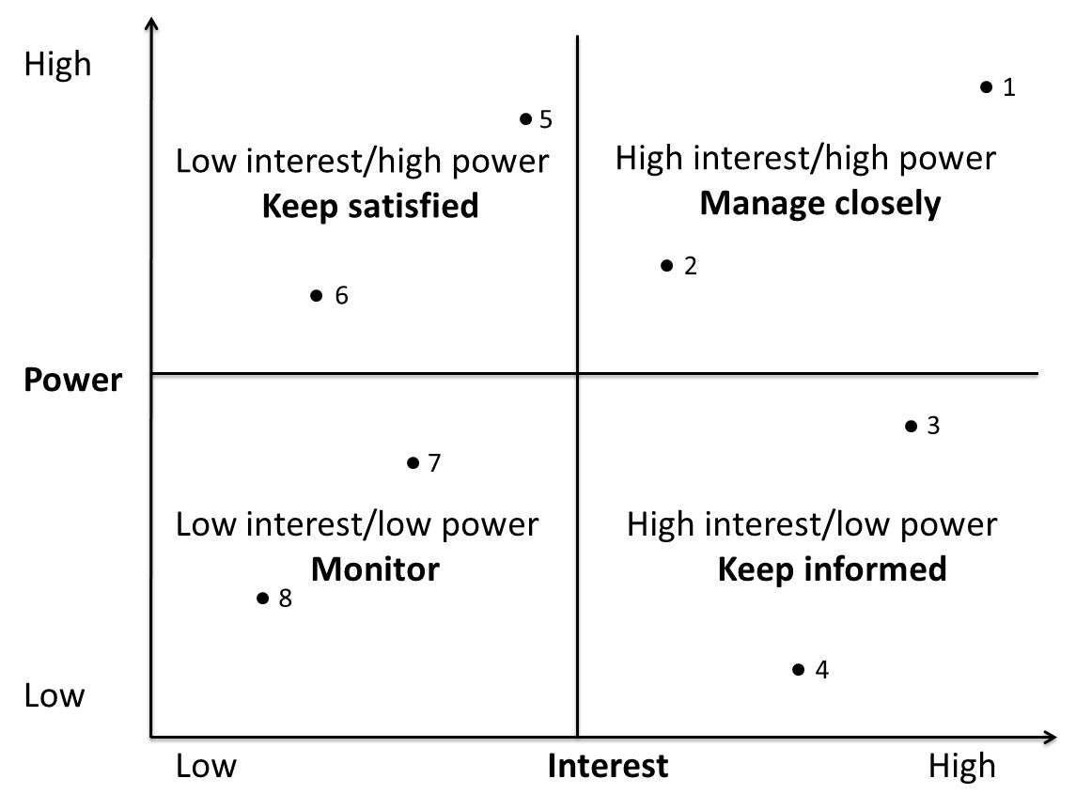
Figure 3-13. Sample Stakeholder Analysis Power/Interest Grid

Slide 32
Categorizing Engagement Levels of Stakeholders
Unaware: Unaware of the project and its potential impacts on them
Resistant: Aware of the project yet resistant to change
Neutral: Aware of the project yet neither supportive nor resistant
Supportive: Aware of the project and supportive of change
Leading: Aware of the project and its potential impacts and actively engaged in helping it succeed

Slide 33
Creating a Project Charter and Assumption Log
A project charter is a document that formally recognizes the existence of a project and provides a summary of the project’s objectives and management
It authorizes the project manager to use organizational resources to complete the project
Ideally, the project manager will play a major role in developing the project charter
Instead of project charters, some organizations initiate projects using a simple letter of agreement or formal contracts
A crucial part of the project charter is the sign-off section

Slide 34
Contents of a Project Charter
The project’s title and date of authorization
The project manager’s name and contact information
A summary schedule or timeline, including the planned start and finish dates; if a summary milestone schedule is available, it should also be included or referenced
A summary of the project’s estimated cost and budget allocation
A brief description of the project objectives, including the business need or other justification for authorizing the project
Project success criteria or approval requirements, including project approval requirements and who signs off on the project

Slide 35
Contents of a Project Charter (continued)
A summary of the planned approach for managing the project, which should describe stakeholder needs and expectations, overall project risk, important assumptions and constraints, and should refer to related documents, such as a communications management plan, as available
A roles and responsibilities matrix
A sign-off section for signatures of key project stakeholders
A comments section in which stakeholders can provide important comments related to the project

Slide 36
Figure 3-15. Sample Project Charter
Project Title: Just-In-Time Training Project Project Start Date: July 1 Projected Finish Date: June 30 (one year later)
Budget Information: The firm has allocated $1,000,000 for this project. Approximately half of these costs will be for internal labor, while the other half will be for outsourced labor and training programs.
Project Manager: Kristin Maur, (610) 752-4896, kmaur@globalconstruction.com
Project Objectives: Develop a new training program that provides just-in-time training to employees on key topics, including supplier management, negotiating skills, project management, and software applications (spreadsheets and Web development). Develop an approach for measuring productivity improvements from this approach to training on an annual basis.
Success Criteria: This project will be successful if it reduces training cost per employee by 10% or $100/employee/year. It should also be completed on time, be run professionally, and meet all of the requirements. The project sponsor will fill out a customer acceptance/project completion form at the end of the project and give the project at least a 7 out of 10 overall rating.

Slide 37
Figure 3-15. Sample Project Charter (continued)
Approach section (partial)
Terminate all internal training courses except the Six Sigma training once new courses are developed
Communicate to all employees the plans to improve internal training and let them know that tuition reimbursement will continue as is.
Roles and Responsibilities
Comments (partial)
“I want to review all of the information related to providing the supplier management training. We need to make something available quickly.” Tim

Slide 38
Contents of An Assumptions Log
An assumption log is a document used to record and track assumptions and constraints throughout the project life cycle.
It aids in communicating information to key stakeholders and avoids potential confusion.
Most projects include several assumptions that affect the scope, time, cost, risk, and other knowledge areas.
It is important to document and validate these assumptions.

Slide 39
Figure 3-16. Sample Assumptions Log
ID | Assumption Description | Category | Owner | Due Date | Status | Actions
108 | Supplier management training should be completed first | Time | Kristin | Sep. 1 | Closed | Scheduled first
122 | Employees will take some of the training during non-work hours | Human resources | Lucy | Nov. 1 | Open | Meet with dept. heads to discuss

Slide 40
Holding a Project Kick-off Meeting
Experienced project managers know that it is crucial to get projects off to a great start.
A kick-off meeting is a meeting held at the beginning of a project so that stakeholders can meet each other, review the goals of the project, and discuss future plans. Note that the PMBOK® Guide – Sixth Edition, suggests that the kick-off meeting be held during the end of the planning or start of the executing process group. In the author’s experience, it is best hold it earlier.
The project champion should speak first and introduce the project sponsor and project manager
There is often a fair amount of work is done to prepare for the meeting.
If it cannot be held face-to-face, try to include audio and/or video to engage and understand participants.

Slide 41
Figure 3-17. Sample Kick-Off Meeting Agenda
Just-In-Time Training Project
Kick-off Meeting
July 16
Meeting Objective: Get the project off to an effective start by introducing key stakeholders, reviewing project goals, and discussing future plans
Agenda:
Introductions of attendees
Review of the project background
Review of project-related documents (i.e., business case, project charter, assumptions log)
Discussion of project organizational structure
Discussion of project scope, time, and cost goals
Discussion of other important topics
List of action items from meeting
Action Item | Assigned To | Due Date
Action Item | Assigned To | Due Date
Date and time of next meeting:
Date and time of next meeting:

Slide 42
Quick Review Question
What are the five project management process groups, and the knowledge areas?
Explain the concept of agile project management.
What are the key initiating process activities?
Who are the project stakeholders?
5. Why is performing a stakeholder analysis important?
6. What are a project charter and assumption log? Why is this important?
7. Describe the importance of holding a good project kick-off
meeting

Slide 43
Summary of Main Teaching Points
The five project management process groups are initiating, planning, executing, monitoring and controlling, and closing. These processes occur at varying levels of intensity throughout each phase of a project, and specific outcomes are produced as a result of each process
Mapping the main activities of each project management process group into the ten project management knowledge areas provides a big picture of what activities are involved in project management

Slide 44
Summary of Main Teaching Points
After a project is approved, senior managers often meet to perform several pre-initiating tasks
The main tasks normally involved in project initiation are the following:
Identifying and stakeholders
Creating the project charter and assumptions log
Holding a kick-off meeting

Slide 45
Question and Answer Session
Q & A

Slide 46
What To Expect Next Week
In Class
Preparation for Class
Planning Projects Part 1
(Integration &Scope)
– Processes and Tools & Techniques
Nil

